Slide 1

Solar Baking stove "Mitad"
Prepared by Eng Mikal Afewerki

Slide 2

Introduction and Background
Aim: Transforming Ethiopian Households and understanding the challenges .
The Solar Mitad Initiative was inspired by the challenges faced by Ethiopian households in conventional cooking practices. Health hazards, deforestation's environmental impact, and soaring electricity bills drove the demand for sustainable alternatives.
Objective: is to create an affordable and user-friendly solar baking stove. This innovation targets the issues related to expensive and polluting traditional cooking methods in Ethiopian households. The initiative's focus is on diminishing reliance on outdated practices, advocating for clean energy, and ensuring broader access to safe cooking/ baking technologies.

Slide 3
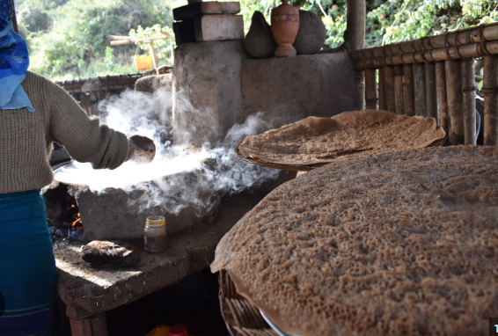
The problem
"Despite being an integral part of Ethiopian households, the art of cooking, especially the traditional practice of baking injera, is perceived as an affordable routine. However, reliance on inefficient technologies leads to prolonged cooking durations, incurring considerable expenses. These inefficiencies significantly impact household economies, highlighting the need for more efficient cooking solutions."

Slide 4
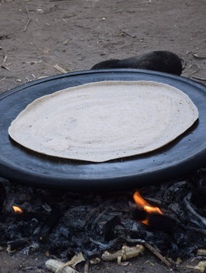
Impact analysis
Title : Consequence of traditional baking .
Health Impact: Combustion of biomass fuels in traditional cookstoves contributes to black carbon formation, impacting human health.
Environmental Impact: Traditional baking methods result in substantial environmental concerns. These include deforestation, air pollution, and carbon emissions,
Financial Impact: The use of inefficient traditional cookstoves imposes a significant economic burden on households. This includes expenses related to fuel, maintenance, and health issues caused by these practices, impacting socio-economic activities negatively.

Slide 5

The Solution
Revolutionizing Solar Efficiency" with product development .
Predictive Models
Data-Driven Techniques
Reconfiguration Strategies: includes insights on reorienting solar panels for better energy capture based on geographical or irradiance data.

Slide 6
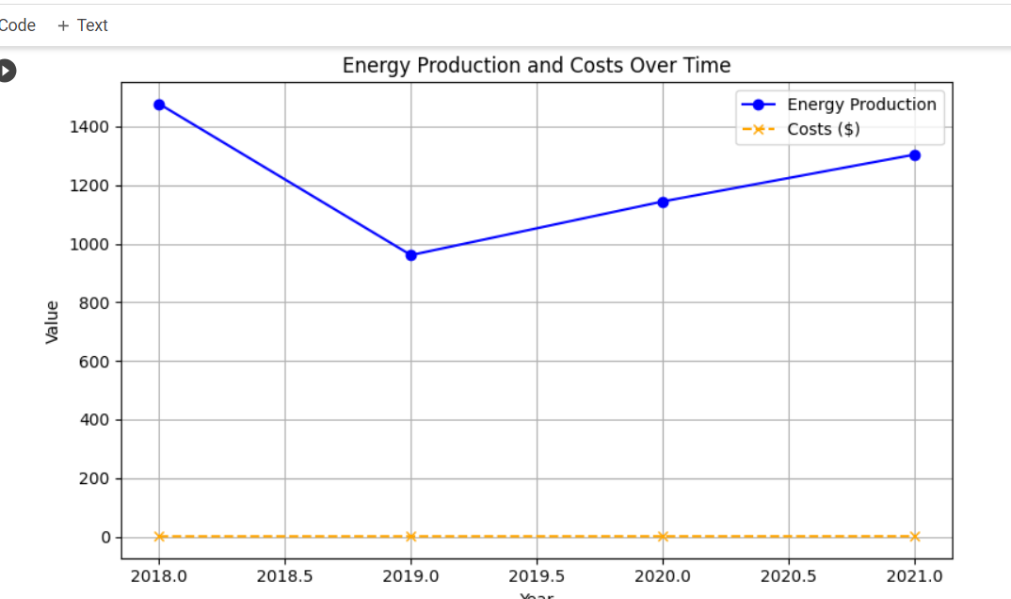
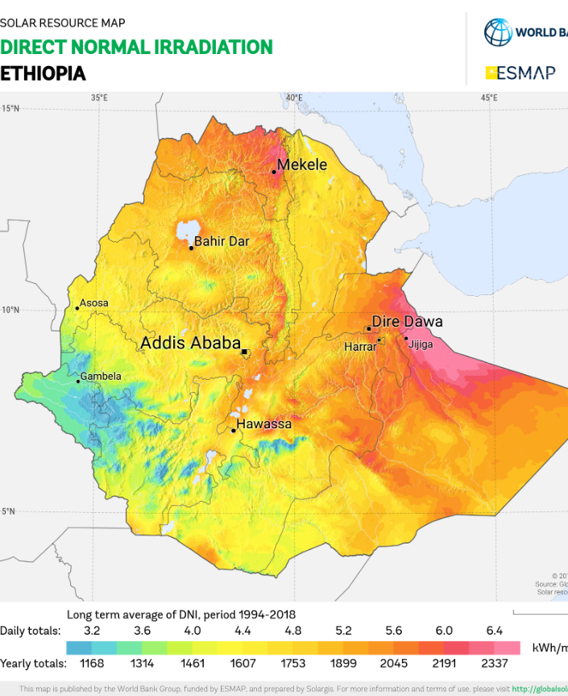
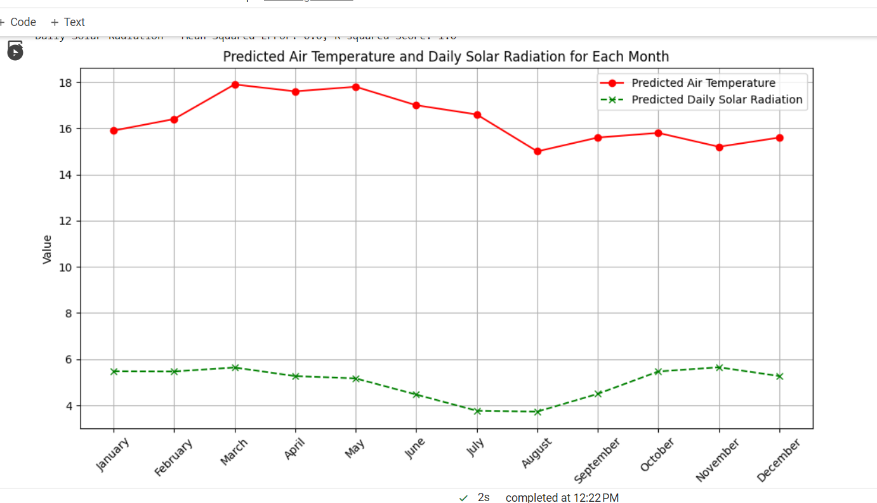

Slide 7

Data Interpretation
Energy Production Visualization:
Line Plot or Bar Chart: Use a line plot to show the trend of energy production over the years or a bar chart to represent energy production values for each year.
Color Coding: Use distinct colors to differentiate between different types of energy sources or production values if applicable.
Axes Labeling: Clearly label the X-axis (Years) and Y-axis (Energy Production in kWh) for easy interpretation.
Title and Legends: Include a descriptive title that captures the essence of the visualization and add a legend if multiple sources or categories are represented.
Cost Visualization:
Bar Chart: Utilize a bar chart to represent costs over time, with each bar depicting the cost for a specific year.
Axis Labels and Title: Label the X-axis (Years) and Y-axis (Cost in $) clearly. The title should convey the focus of the visualization.
Color and Annotations: Use color to highlight any significant changes or specific data points. Annotations can be helpful to explain exceptional or noteworthy years.

Slide 8
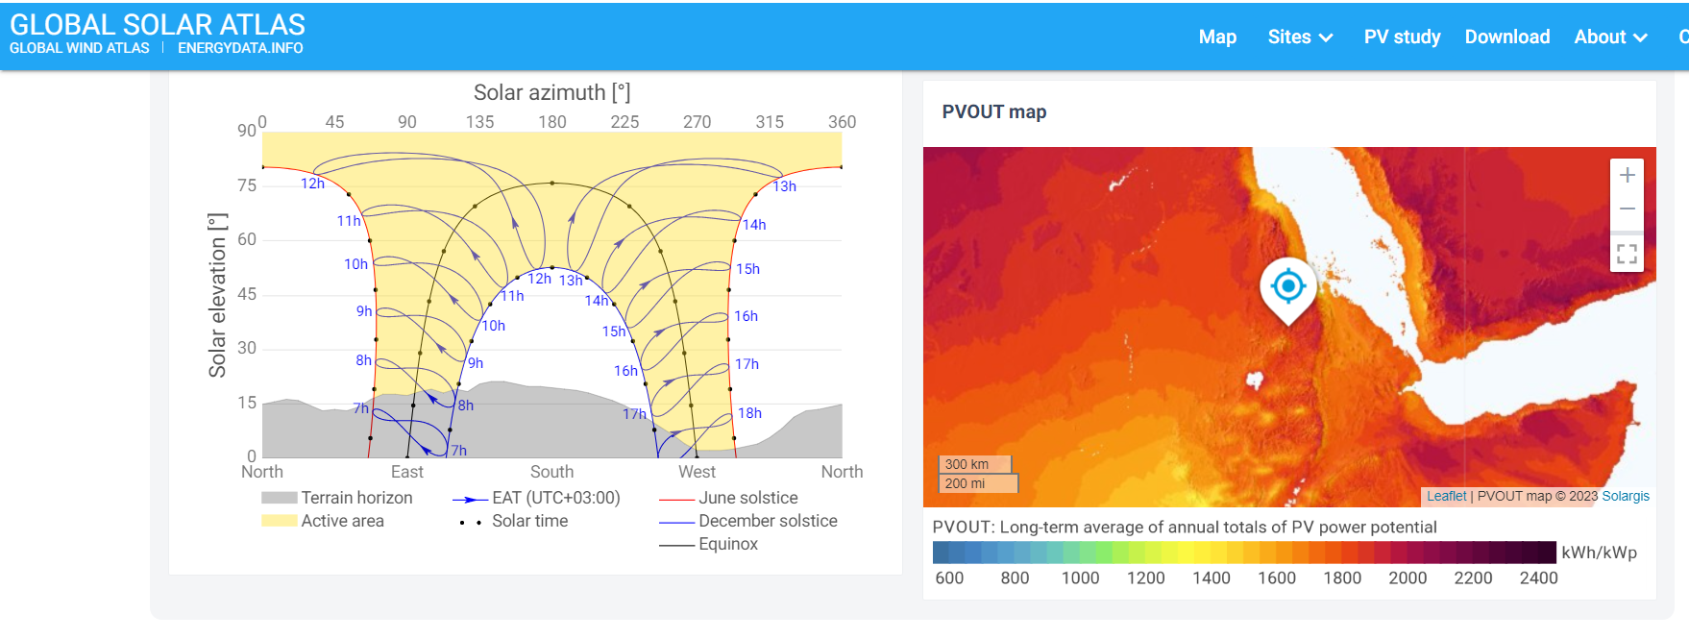
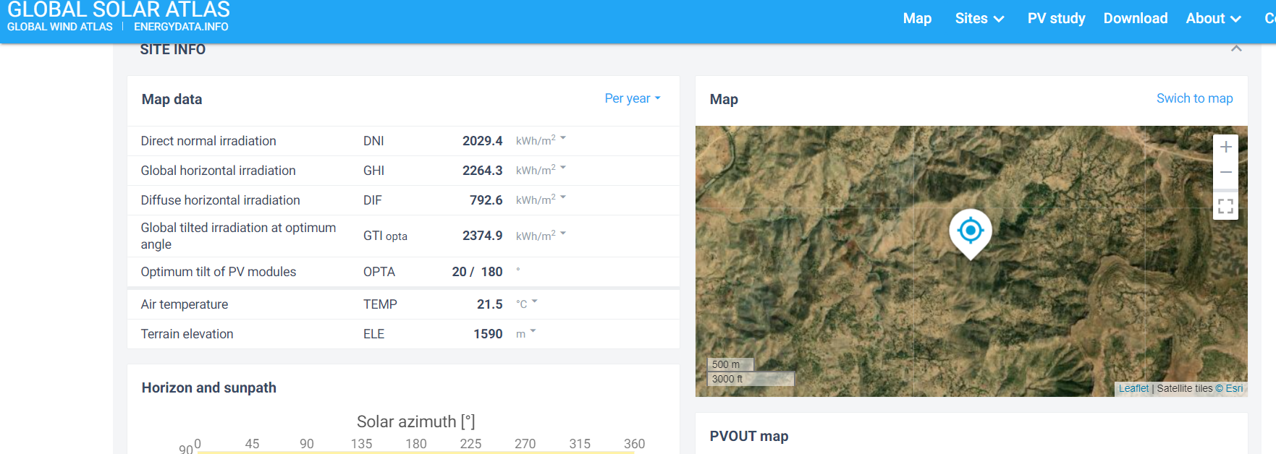

Slide 9
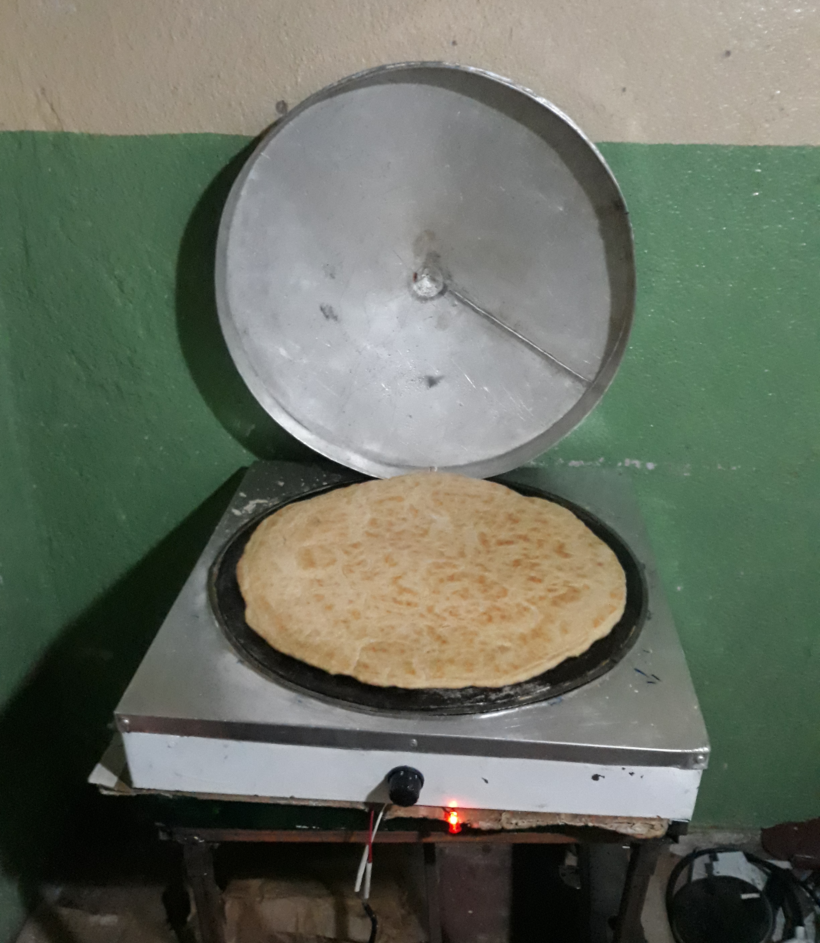
Welcome To Data Driven Technique
"Elevating Baking Efficiency: Embracing Data-Driven Solutions".
A transformative journey where data takes center stage in revolutionizing baking efficiency.
Power of data-driven techniques to refine and optimize the art of baking. By harnessing the insights derived from extensive data analysis, predictive modeling, and rigorous testing.
Aim: to craft an innovative product that transcends conventional baking norms.
Approach: combines cutting-edge data methodologies with the iterative process of product development, constantly refining and optimizing the solutions.

Slide 10

Implementation plan
Overview: strategic steps to implement proposed changes in baking practices.
Objectives: specific goal is to achieve baking process optimization.
Resource Allocation: necessary resources such as manpower, technology, and budget for each stage of implementation.
Timeline: Record a timeline when each phase of the plan will commence and complete.
Testing and Iteration:physical and data test to the innovations, and collecting feedback, and iterating for improvements

Slide 11

Expected Outcomes
Energy Yield Enhancement:I ncreases in energy production by adopting optimized baking practices.
Environmental Impact: minimized deforestation, or other ecological benefits through eco-friendly baking practices.
Quantifiable Metrics: quantifiable metrics to reinforce the expected outcomes and their significance.
Summary : the overall positive impact of the initiative on energy efficiency, cost-effectiveness, and environmental sustainability.

Slide 12
Conclusion And Call To Action
Aim :commitment to transformation.
Summary of Purpose: key points addressed throughout the presentation, including the challenges, proposed solutions, and anticipated outcomes.
Impact Statement: impact of the initiative on Ethiopian households, emphasizing improvements in baking practices, energy efficiency, cost savings, and environmental sustainability.
Call to Action: Encourage stakeholder engagement and collaboration. I want Invite participation from the audience, be it investors, policymakers, or community members, to join in and support the initiative. Emphasize the importance of collective efforts in driving positive change.
Next Steps: Avenues for involvement, such as workshops, partnerships, funding opportunities, or community engagement initiatives.
Remarks Gratitude to Erico Santos and Evan Cole for their mentorship . and ABW Analytics

Slide 13

Closing Remark
Gratitude to the audience for their attention and interest.
The commitment from ABW to the determination toward this Endeavor .
Finally to my mentors
Erico Santos and Evan Cole

Slide 14

Q and A

